Slide 1
Data Mining
HR Analytics: Predict Employee Attrition
CART, Random Forest and Artificial Neural Net.
By: Dushyant Bhavsar

Slide 2
INDEX
Objective
Data Summary
Exploratory Data Analysis
Hypothesis and validation
Model implementation and strategy
Conclusion/Take-away

Slide 3
Objective
Employee attrition is predictable under stable circumstances, wherein a set pattern can be deduced from certain parameters influencing the employee and the organization at all times. Some of these parameters could be foreseeable such as retirement age or unforeseeable such as company performance, external funding, management shakeup etc.
However, who is going to leave, when and why, can be answered based on analytical models developed as a result of data analysis.
Through predictive algorithms, companies gain better understanding and can undertake preventive measures for employee attrition

Slide 4
Data Summary
We have used HR_Employee_Attrition_Data.csv file for our analysis
This file has got total 35 variables of mixed datatypes
Out of 35 variables, 9 are categorical variables
Total 2940 records/observation
With Attrition/Target rate ratio 4:21 –(Yes:No)

Slide 5
Exploratory Data Analysis & Preparation
Data Exploration is a crucial stage of predictive model. We can’t build great and practical models unless we learn and explore the data from begin to end.
This step can be done by visualization and analysis using excel/R
Variable Identification:
This dataset has got 1 Response and 34 predictor/explanatory variables

Slide 6
Exploratory Data Analysis & Preparation
Univariate Analysis: explore variables one by one for Central Tendency, Measure of dispersion etc.
# converting all factor variable into numeric
eg. HREA$Department <- as.numeric(as.factor(HREA$Department))
#check for missing values in data set (using R)
table(is.na(HREA))
colSums(is.na(HREA))
# Normality analysis via Histogram (Visual -refer next slide)
eg. hist(HREA$DailyRate, main ="DailyRate",xlab="")

Slide 7
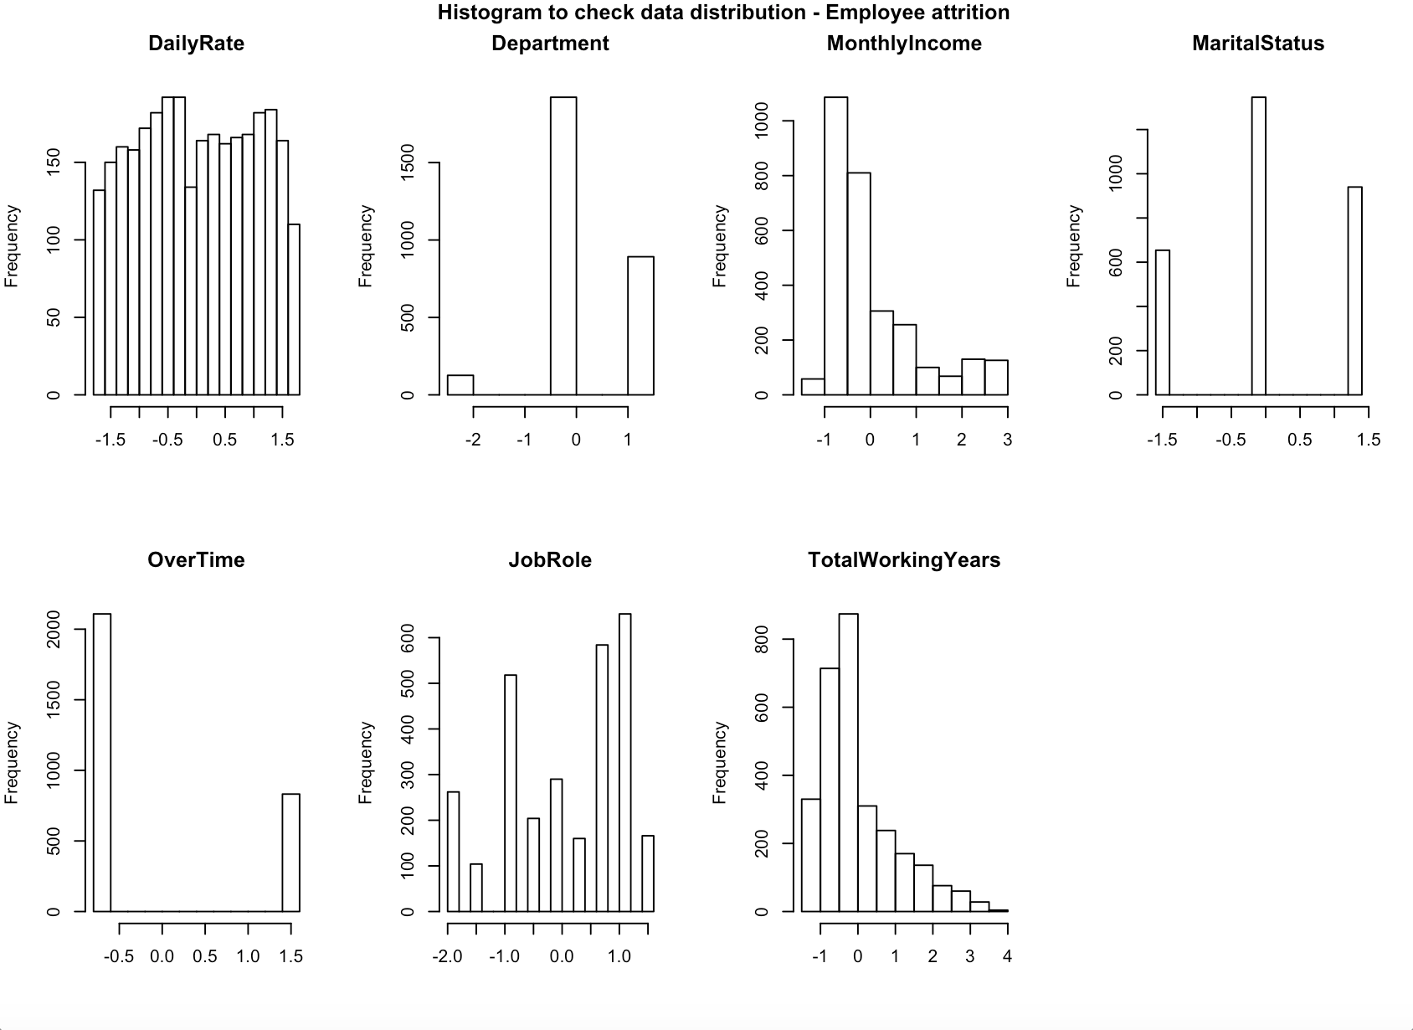

Slide 8
Exploratory Data Analysis & Preparation
#Outlier checking using Boxplot (Visual -refer next slide)
eg. boxplot(HREA$DailyRate, main ="DailyRate",xlab="")
Drop unwanted or non-contributing variables from data set (post visual analysis)
#drop unwanted columns (using R)
rp <- c(9,10,20,22,27) – Employee count, number, Over18, Std. Hrs, rate
HREA <- (HREA[, -rp])
#Check skewness in data
eg. skewness(HREA.scaled$MonthlyIncome)
#scaling the variables/transformation (except target variable)
eg. HREA.scaled <- scale(HREA)

Slide 9
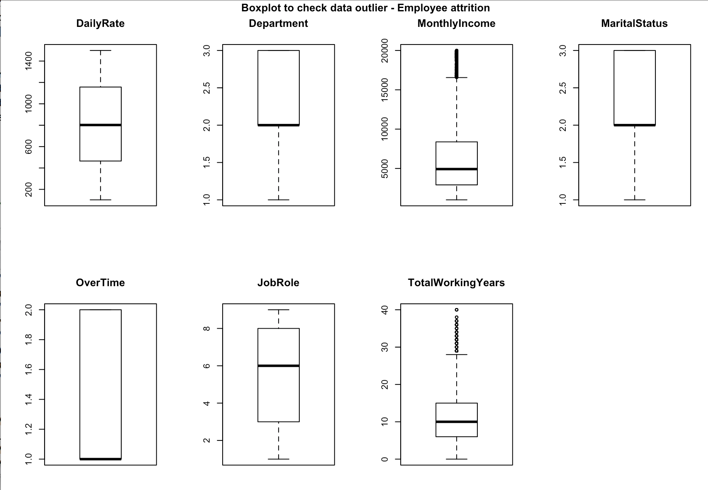

Slide 10
Exploratory Data Analysis & Preparation
Data preparation :
# Creating Development and Holdout Sample
2189 scaled records for model development with attrition rate ratio 15:85
751 scaled unseen records as holdout sample with attrition rate ratio 18:82
both above derived randomly from 2940 scaled records

Slide 11
Hypothesis
Null Hypothesis(Ho): Predictor variables in HREA dataset do not contribute to predict employee attrition i.e. there is no linear relationship between employee attrition and all other predictor variables.
Alternate Hypothesis(H1): There is a linear relationship between employee attrition and predictor variables i.e. all or some have power to predict attrition

Slide 12
Hypothesis validation using Linear regression
##Run Linear regression to find significant independent variables from HR Data set
ft <- lm(Target~ ., data = nn.scaled),
Summary(ft)
Result: p-value: < 0.00000000000000022204
Assuming alpha value to be 0.01, p-value above is far below alpha and Hence, we can safely reject null hypothesis stating – some or all predictor variables in HREA dataset contribute to predict employee attrition

Slide 13
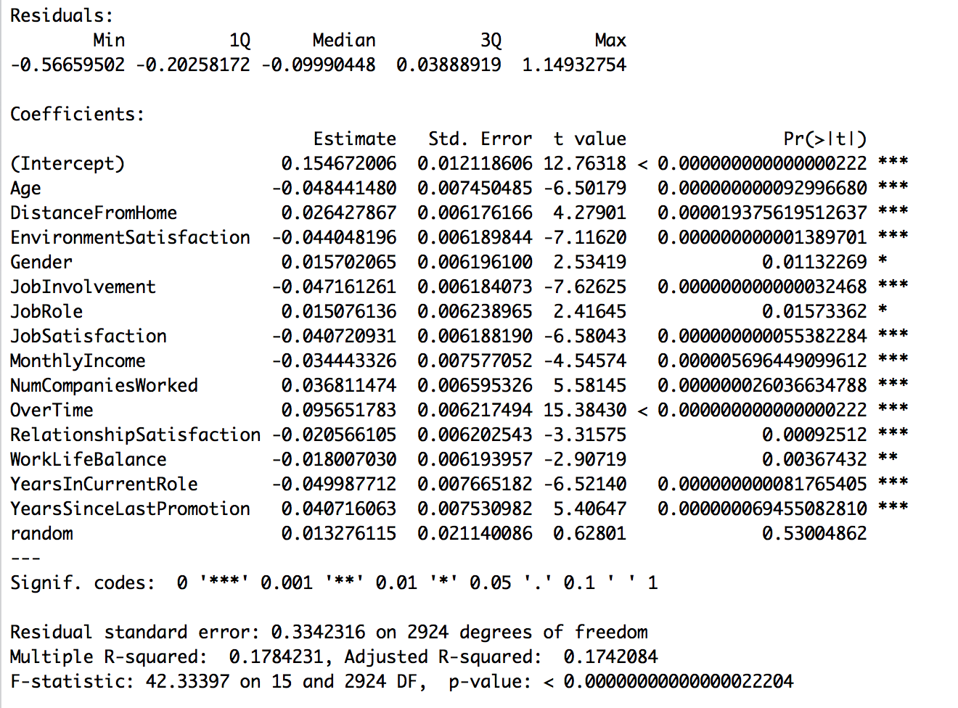
Hypothesis validation using Linear regression
Further , lmtest followed by vif gives below list of significant variables from data set

Slide 14
Let’s build model now
Classification and Regression Tree (CART)

Slide 15
CART
How CART can help us infer and then predict attrition data –
We build Full CART model using scaled CTDF.dev dataset prepared in EDA&P
Using printcp function calculate cp value and rebuild pruned CART model
Create decile and then Rank order on development model based on predicted output
Calculate and print Rank table, auc, ks, gini and confusion matrix on dev. sample(refer screenshot on next slide)

Slide 16
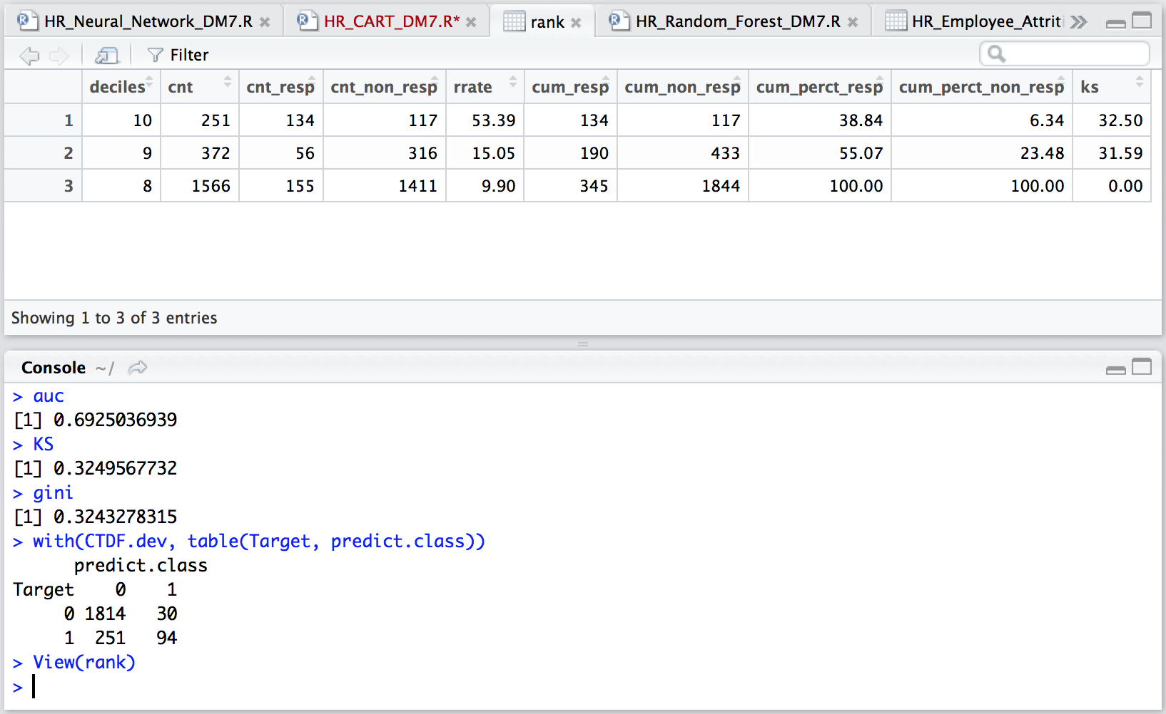

Slide 17
Analyzing CART development model performance
Looking at performance measure of development Model m1:
Rank table: Top decile has 53.39% response rate i.e. 3.6times 15% overall response before applying CART algorithm.
Confusion Matrix: Correctness of prediction is 87.16%

Slide 18
Run CART model on Holdout data

Slide 19
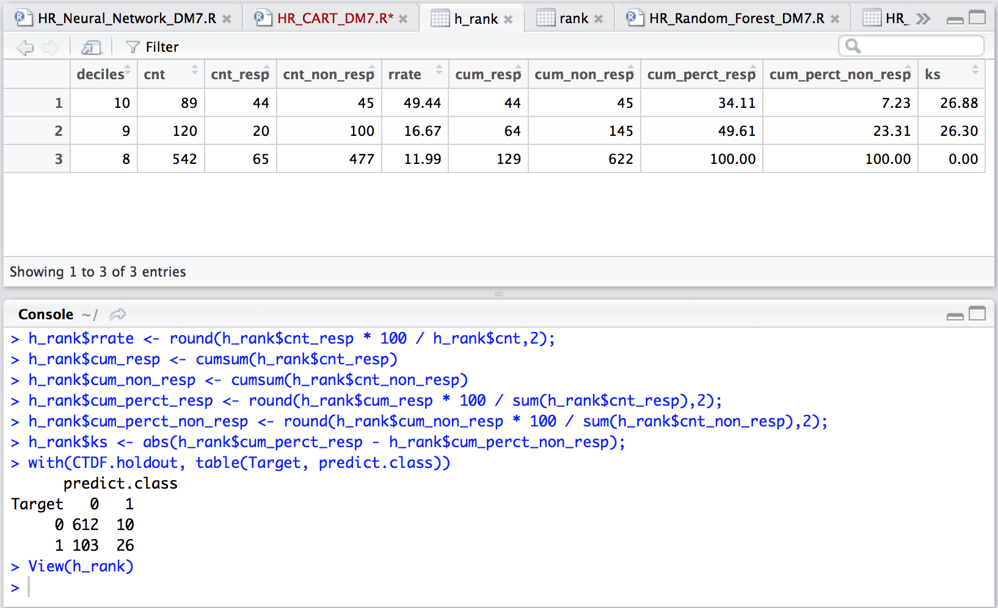

Slide 20
Analyzing CART model m1 on unseen holdout data
Looking at performance measure of Model m1 on unseen data:
Rank table: Top decile has 49.44% response rate i.e. 2.8 times 18% overall response before applying CART algorithm.
Confusion Matrix: Correctness of prediction is 85%.

Slide 21
Take-away
Advantages of CART
Disadvantages of CART
Simple to use and understand
White box – shows which all variables considered to build tree
Provided reasonably good prediction on unseen data 85% correct
Did not perform well on unbalanced data – Target rate16:84
Only 3 decile rank order could be generated
Could provide only 2.8times lift in top decile and then drastic fall in subsequent deciles
Prone to over fitting

Slide 22
Let’s build model now
Random forest

Slide 23
Random Forest(RF)
How RF can help us infer and then predict attrition data –
We build Full RF model using scaled RFDF.dev dataset prepared in EDA&P
Plot OOB chart and rebuild pruned RF model based on OOB
Create deciles and then Rank order for development model based on predicted output
Calculate and print Rank table, auc, ks, gini and confusion matrix on dev. sample(refer screenshot on next slide)

Slide 24
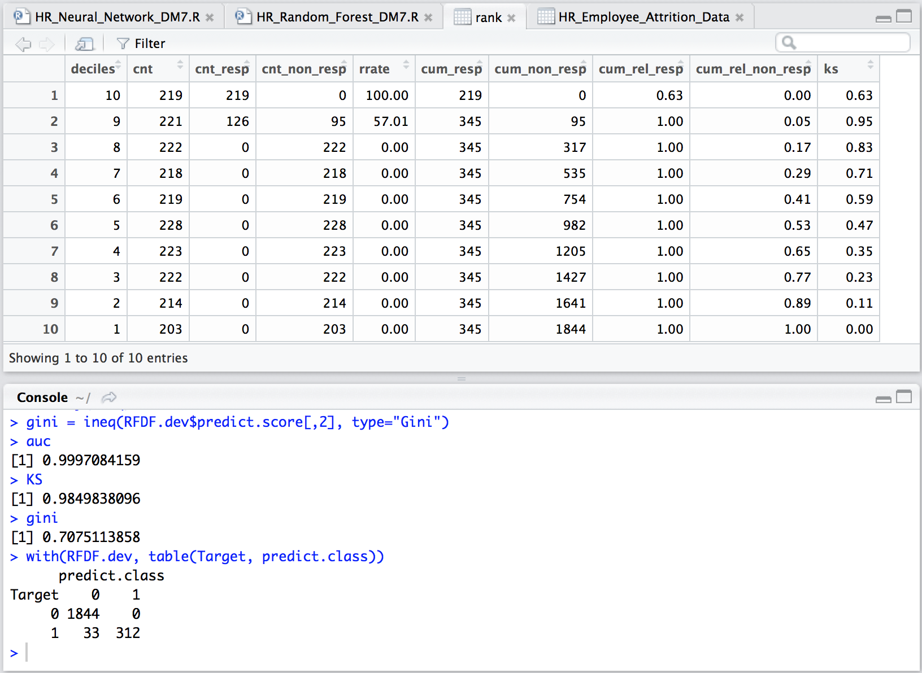

Slide 25
Analyzing RF development model performance
Looking at performance measure of development Model rf1:
Rank table: Top decile has 100% response rate i.e. 6.7times 15% overall response before applying RF algorithm.
Confusion Matrix: Correctness of prediction is 98.49%

Slide 26
Run RF model on Holdout data

Slide 27
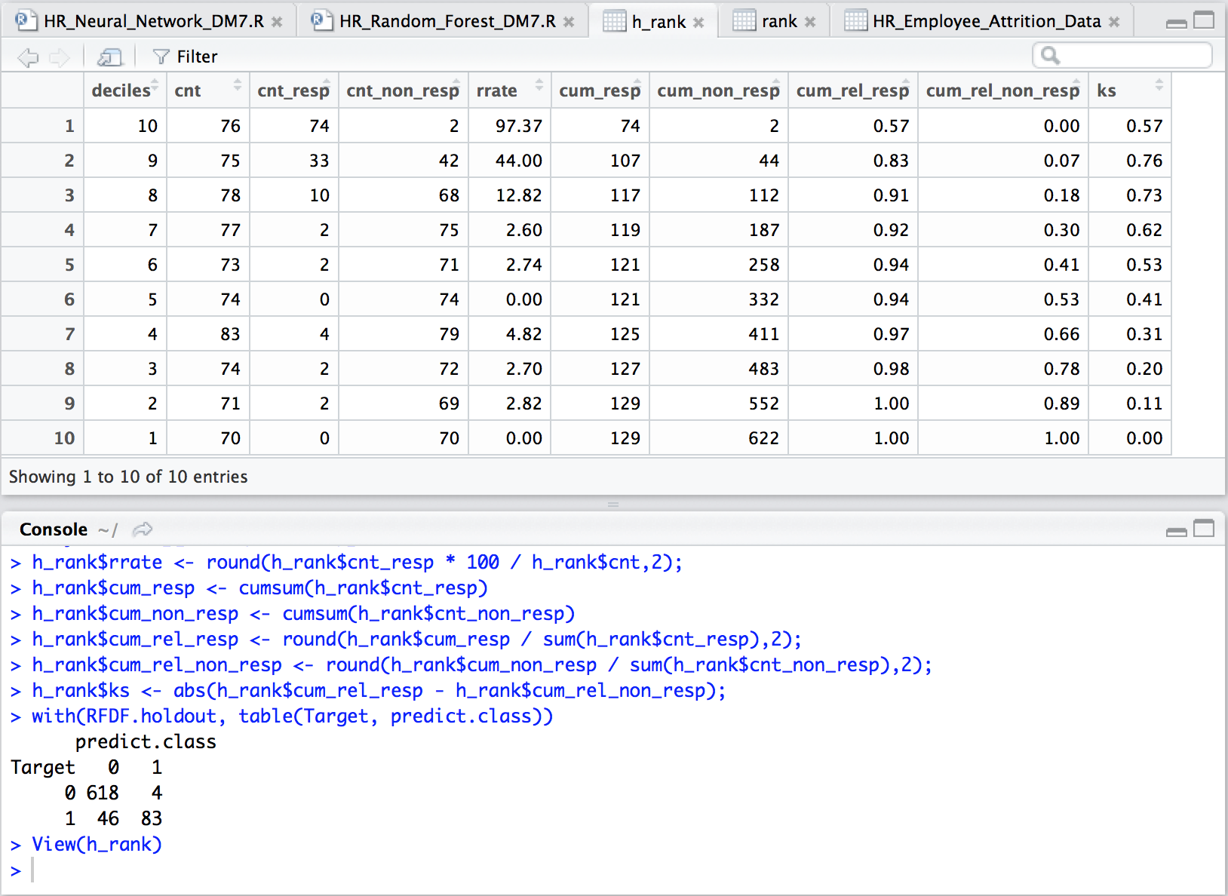

Slide 28
Analyzing RF model on unseen holdout data
Looking at performance measure of Model rf1 on unseen data:
Rank table: Top decile has 97.37% response rate i.e. 5.4 times 18% overall response before applying RF algorithm.
Confusion Matrix: Correctness of prediction is 93%.

Slide 29
Take-away
Advantages of RF
Disadvantages of RF
Overcomes over fitting seen in CART due to ensemble nature
Performs adequately good on unbalanced data full 10 deciles
Provided very good prediction on unseen data 93% correct
Black box – no visibility on feature contribution
Complex and difficult to understand
One has to try several combinations of control parameters to get desired gain
Works only on continuous/numeric variables

Slide 30
Let’s build model now
Artificial Neural Network

Slide 31
Artificial Neural Network(ANN)
How ANN can help us infer and then predict attrition data –
We build Full nn1 model using scaled nn.dev dataset prepared in EDA&P with only Linear regression significant independent variables (refer slide 12,13 and 23)
Check and plot distribution of estimated probabilities to set class threshold for 0/1 class
Create deciles, Rank order and class assignment for development model based on model predicted output
Calculate and print Rank table, auc, ks, gini and confusion matrix on dev. sample(refer screenshot on next slide)

Slide 32
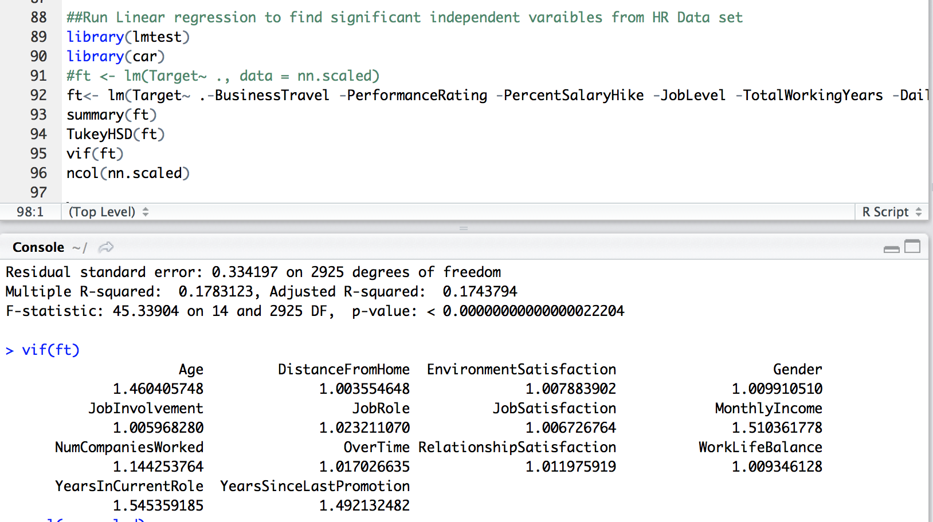

Slide 33
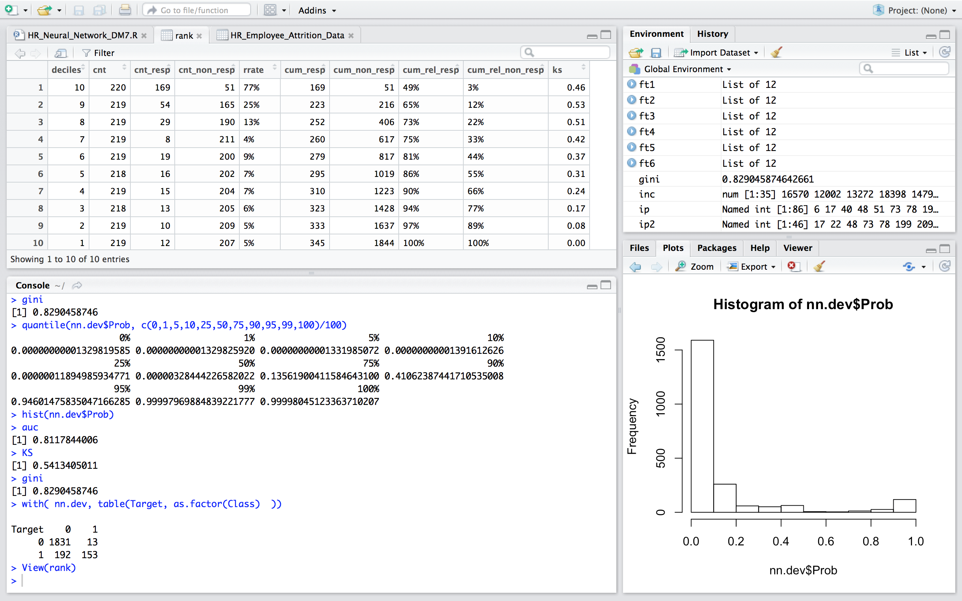

Slide 34
Analyzing ANN development model performance
Looking at performance measure of development Model nn1:
Rank table: Top decile has 77% response rate i.e. 5.1 times 15% overall response before applying ANN algorithm.
Confusion Matrix: Correctness of prediction is 90.63%

Slide 35
Run nn1 model on Holdout data

Slide 36
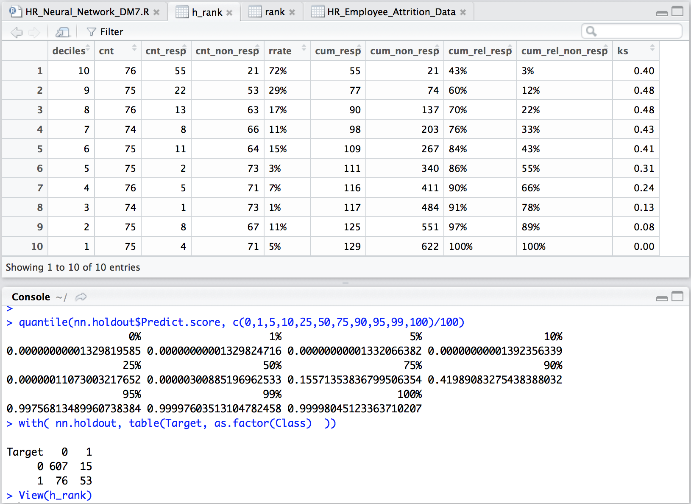

Slide 37
Analyzing ANN model on unseen holdout data
Looking at performance measure of Model nn1 on unseen data:
Rank table: Top decile has 72% response rate i.e. 4 times 18% overall response before applying ANN algorithm.
Confusion Matrix: Correctness of prediction is 88%.

Slide 38
Take-away
Advantages of ANN
Disadvantages of ANN
Overcomes over fitting seen in CART due to ensemble nature
Performs adequately good on unbalanced data full 10 deciles
Provided good prediction on unseen data 88% correct
Black box – no visibility on feature contribution
Complex and difficult to understand
Scaling is must for dataset/variables
Works only on continuous/numeric variables
User has to assign class 0/1manually studying probability score generated by model

Slide 39
Thank You

Slide 40
Thank You
Please share your feedback/recmmondation
Contact: Dushyant Bhavsar
Email: bhavsar.dushyant@gmail.com
LinkedIn: https://www.linkedin.com/in/dushyant-bhavsar-02b11125

